Slide 1
MCB 5472
Comments on
bipartitions, quartets and supertrees

Slide 2
student evaluations
Please go to husky CT and complete student evaluations !

Slide 3
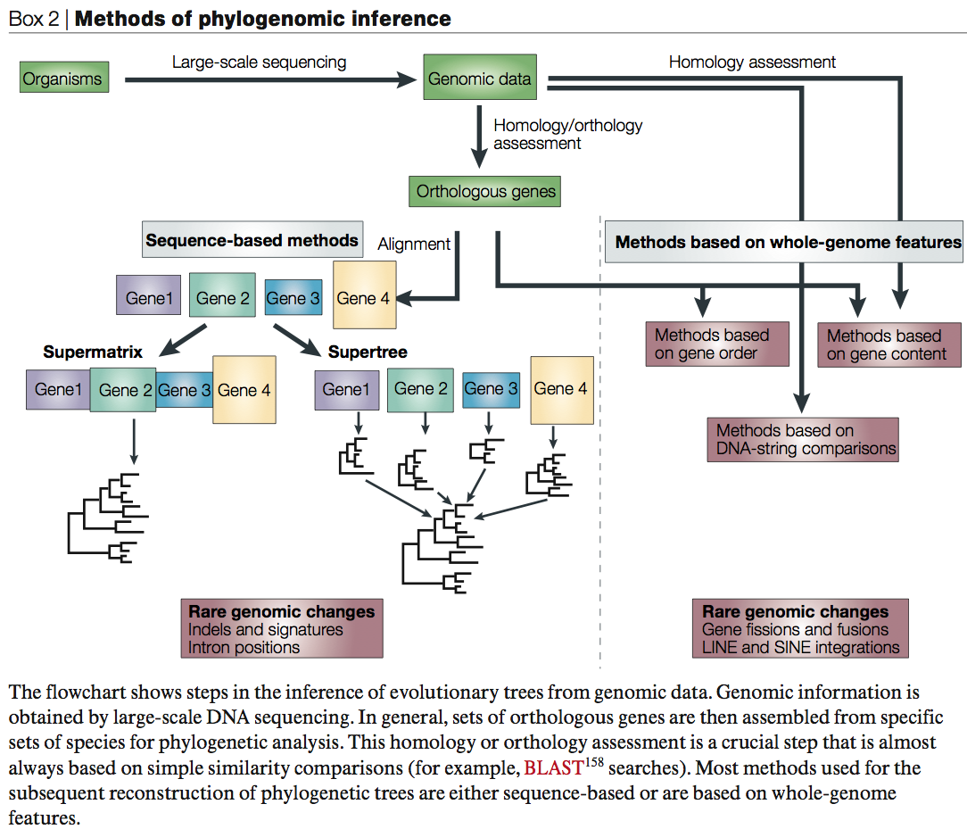
From:
Delsuc F, Brinkmann H, Philippe H.
Phylogenomics and the reconstruction of the tree of life.
Nat Rev Genet. 2005 May;6(5):361-75.

Slide 4
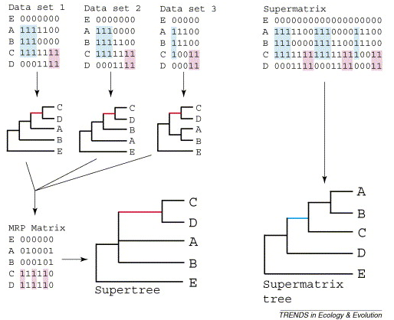
Supertree vs. Supermatrix
From:
Alan de Queiroz John Gatesy:
The supermatrix approach to systematics
Trends Ecol Evol. 2007 Jan;22(1):34-41
Schematic of MRP supertree (left) and parsimony supermatrix (right) approaches to the analysis of three data sets. Clade C+D is supported by all three separate data sets, but not by the supermatrix. Synapomorphies for clade C+D are highlighted in pink. Clade A+B+C is not supported by separate analyses of the three data sets, but is supported by the supermatrix. Synapomorphies for clade A+B+C are highlighted in blue. E is the outgroup used to root the tree.

Slide 5

Johann Heinrich Füssli
Odysseus vor Scilla und Charybdis
From: http://en.wikipedia.org/wiki/File:Johann_Heinrich_F%C3%BCssli_054.jpg

Slide 6
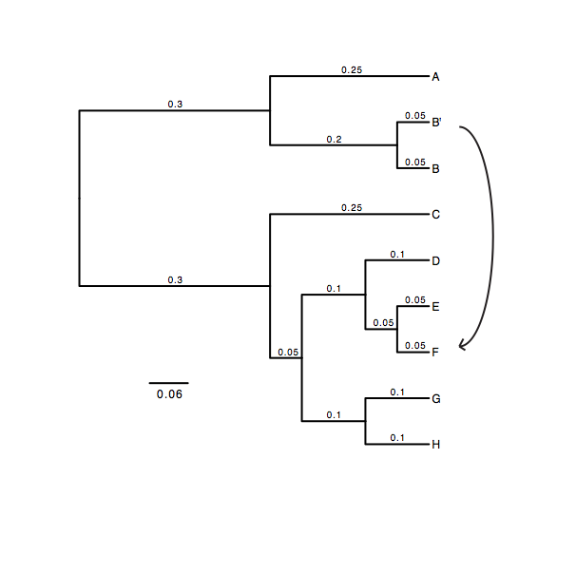
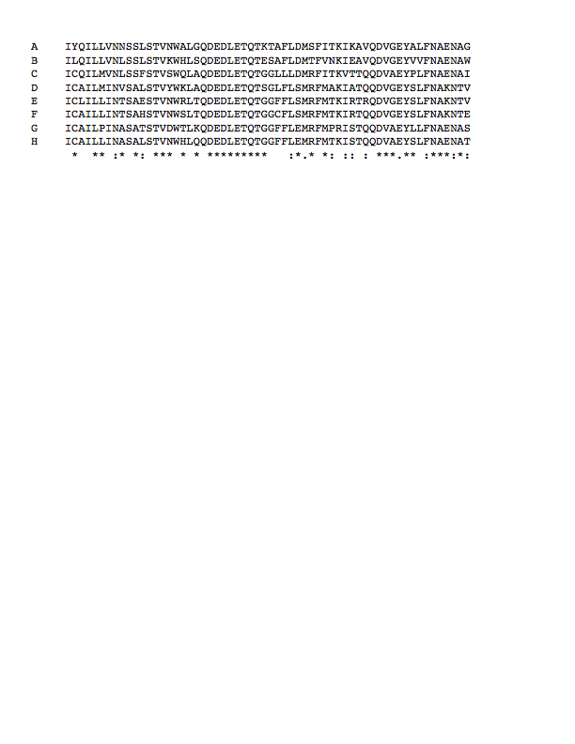
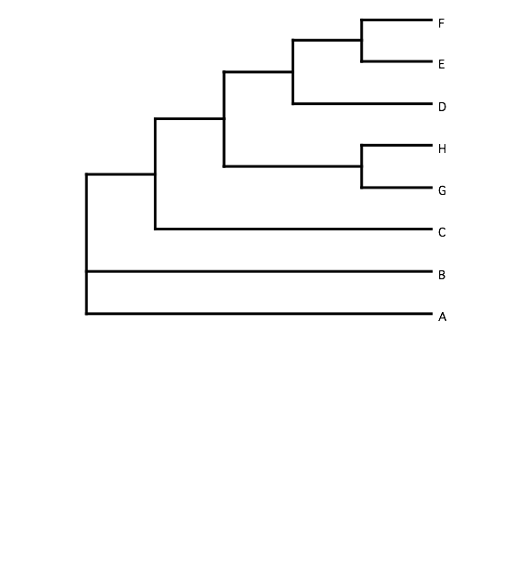
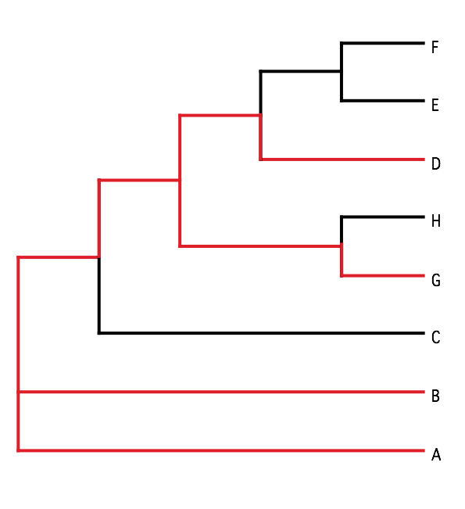
B) Generate 100 datasets using Evolver with certain amount of HGTs
A) Template tree
C) Calculate 1 tree using the concatenated dataset or 100 individual trees
D) Calculate Quartet based tree using Quartet Suite
Repeated 100 times…

Slide 7
Supermatrix versus
Quartet based Supertree
inset: simulated phylogeny

Slide 8
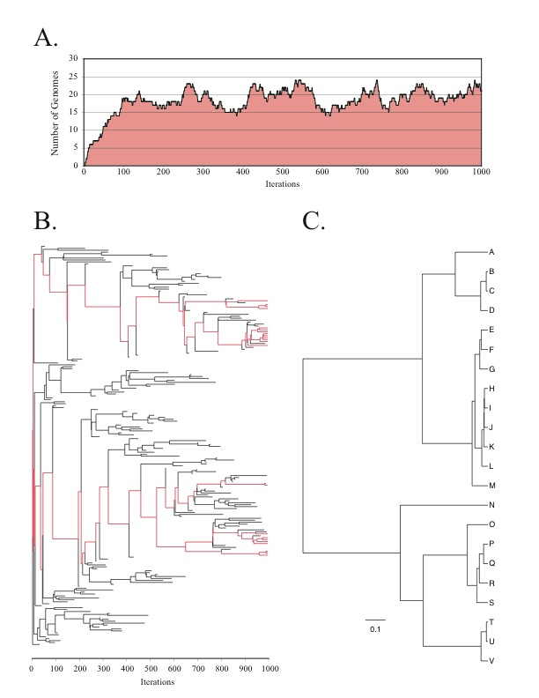
Note : Using same genome seed random number will reproduce same genome history
From: Lapierre P, Lasek-Nesselquist E, and Gogarten JP (2012)
The impact of HGT on phylogenomic reconstruction methods
Brief Bioinform [first published online August 20, 2012] doi:10.1093/bib/bbs050

Slide 9
HGT EvolSimulator Results

Slide 11
See http://bib.oxfordjournals.org/content/15/1/79.full for more information.

Slide 12
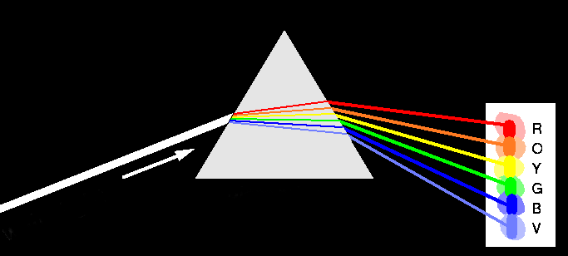
Decomposition of Phylogenetic Data
Phylogenetic information
present in genomes
Break information
into small quanta
of information
Analyze spectra to detect transferred genes and plurality consensus.

Slide 13

TOOLS TO ANALYZE PHYLOGENETIC INFORMATION FROM MULTIPLE GENES IN GENOMES:
Bipartition Spectra (Lento Plots)

Slide 14
BIPARTITION OF A PHYLOGENETIC TREE
Bipartition (or split) – a division of a phylogenetic tree into two parts that are connected by a single branch.
It divides a dataset into two groups, but it does not consider the relationships within each of the two groups.
Yellow vs Rest
* * * . . . * *
95
compatible to illustrated
bipartition
Orange vs Rest
. . * . . . . *
* * * . . . . .
incompatible to illustrated
bipartition

Slide 15
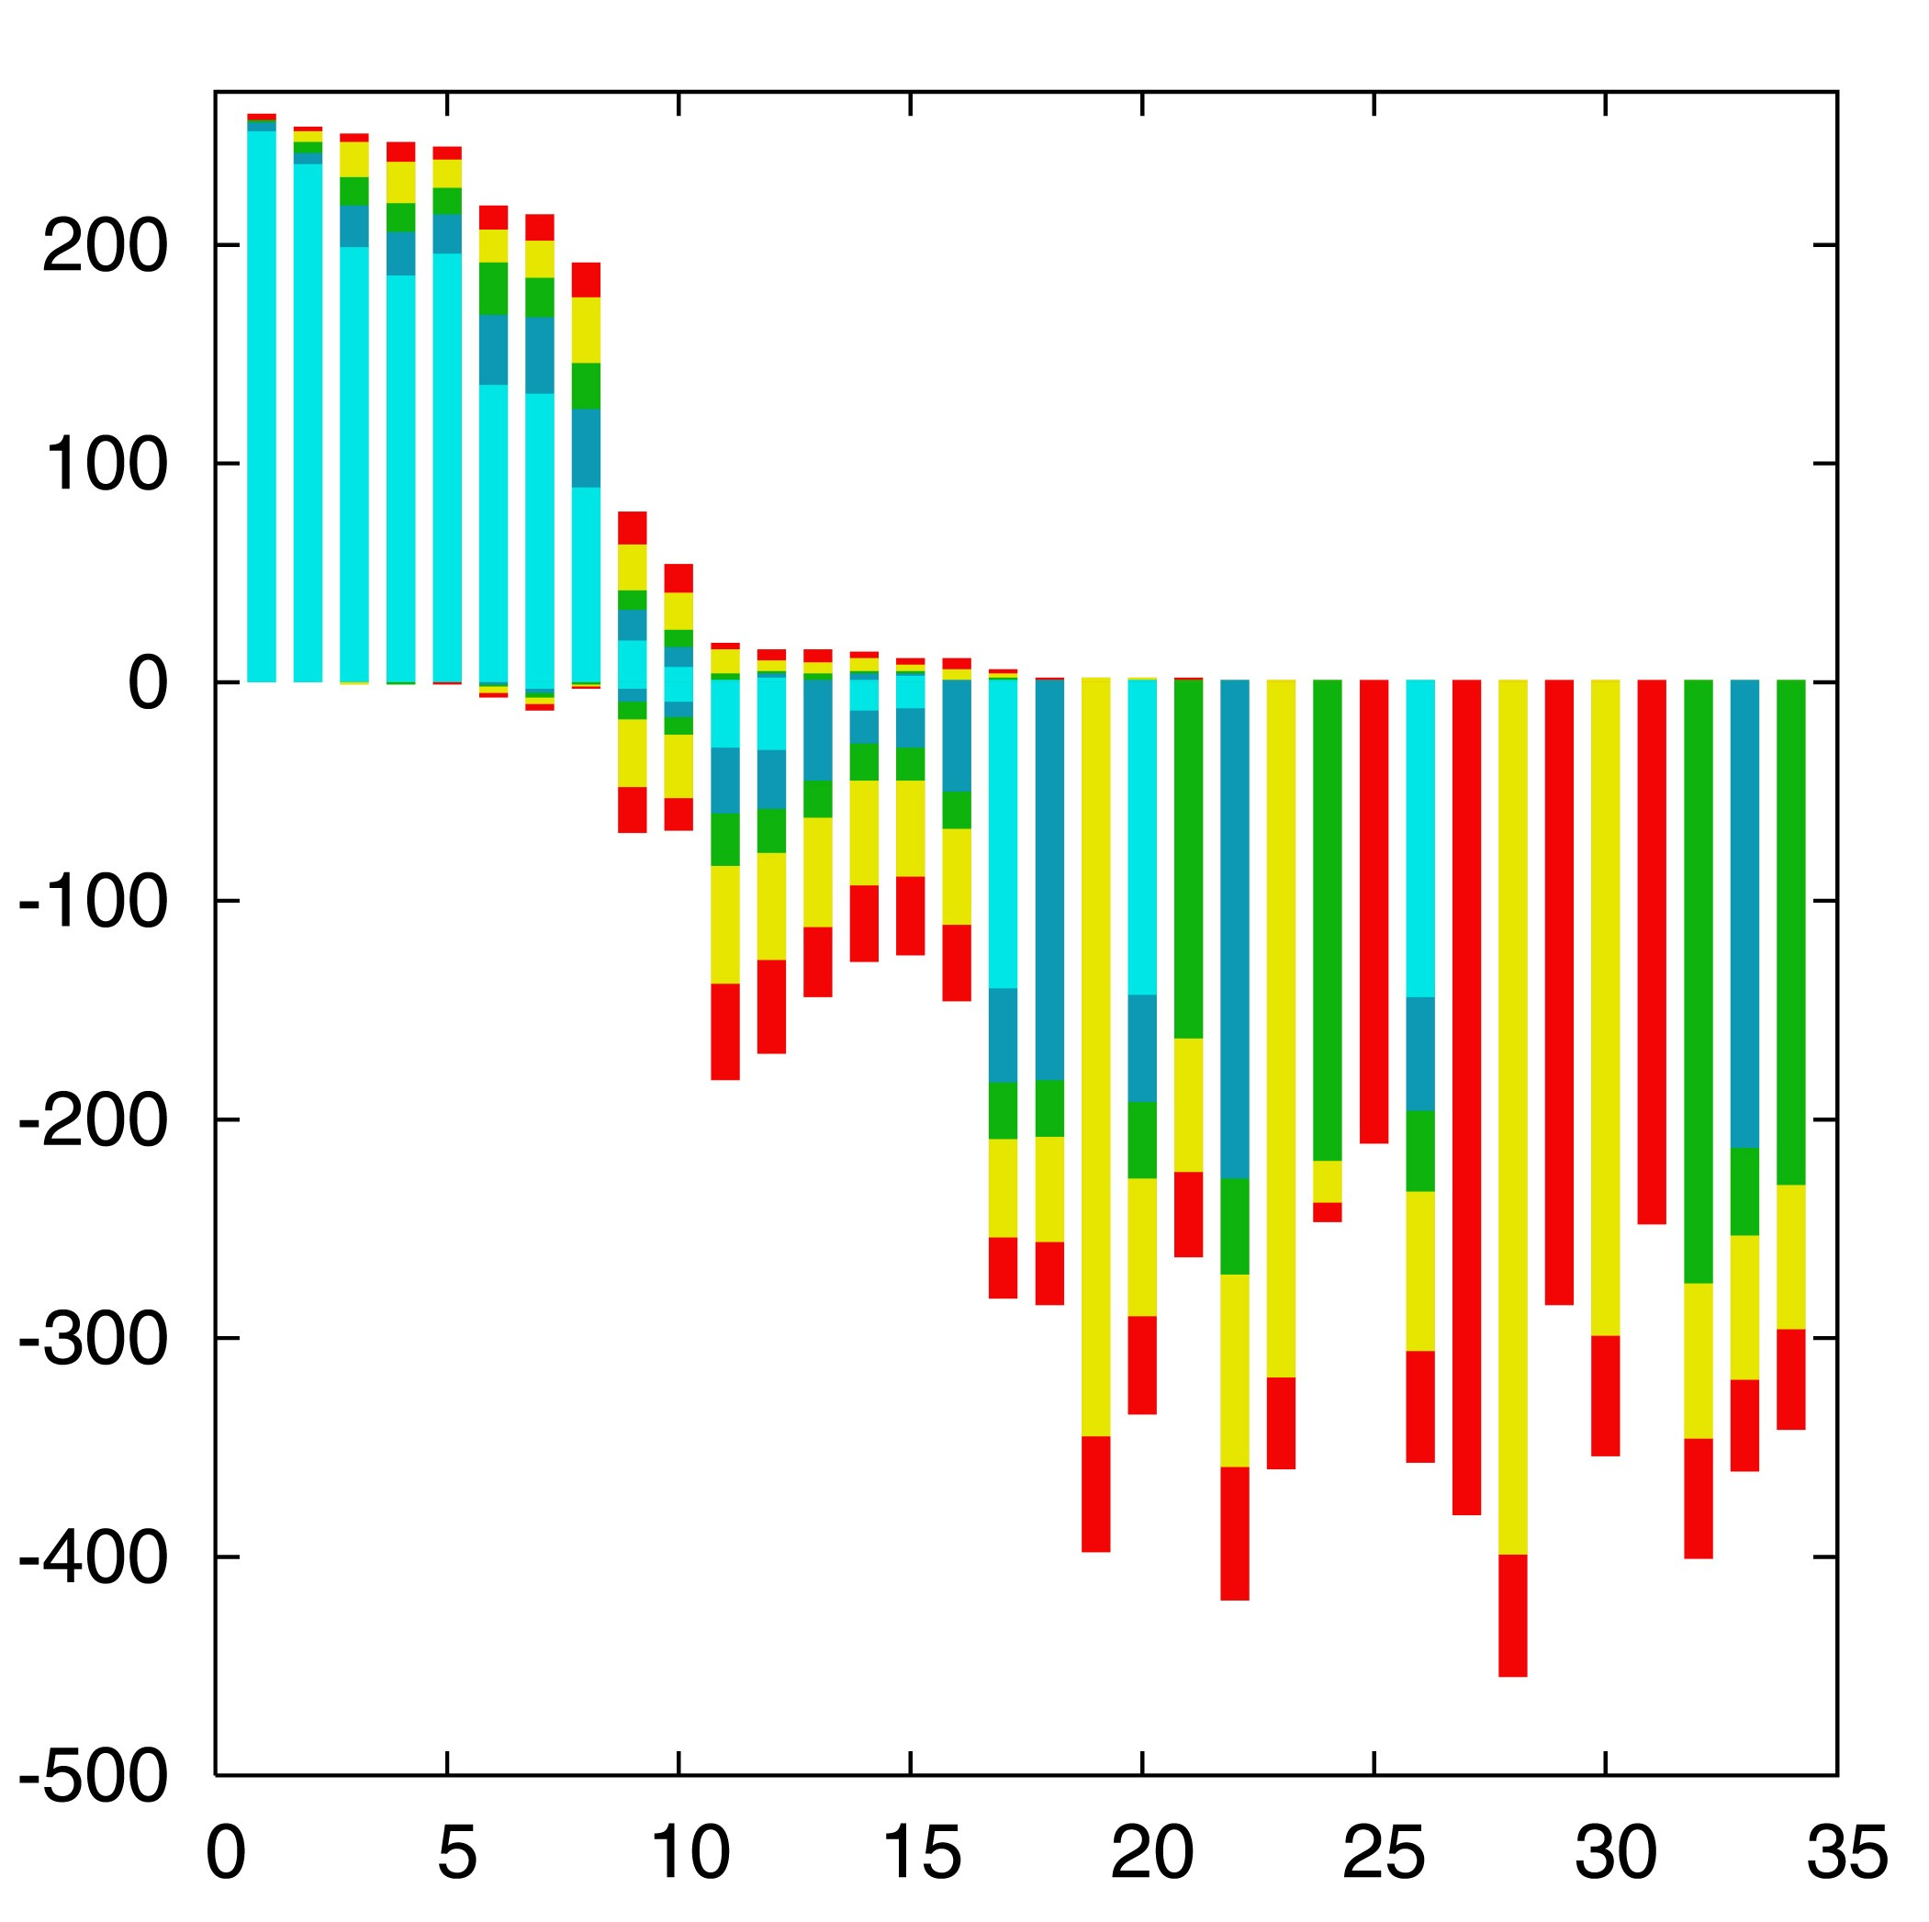

“Lento”-plot of 34 supported bipartitions (out of 4082 possible)
13 gamma-
proteobacterial
genomes
(258 putative
orthologs):
E.coli
Buchnera
Haemophilus
Pasteurella
Salmonella
Yersinia pestis
(2 strains)
Vibrio
Xanthomonas
(2 sp.)
Pseudomonas
Wigglesworthia
There are 13,749,310,575 possible unrooted tree topologies for 13 genomes

Slide 16
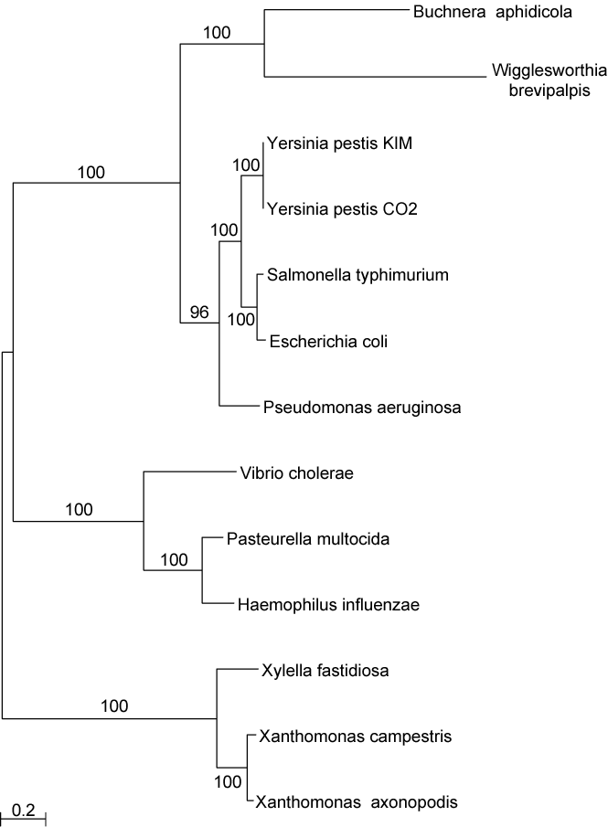
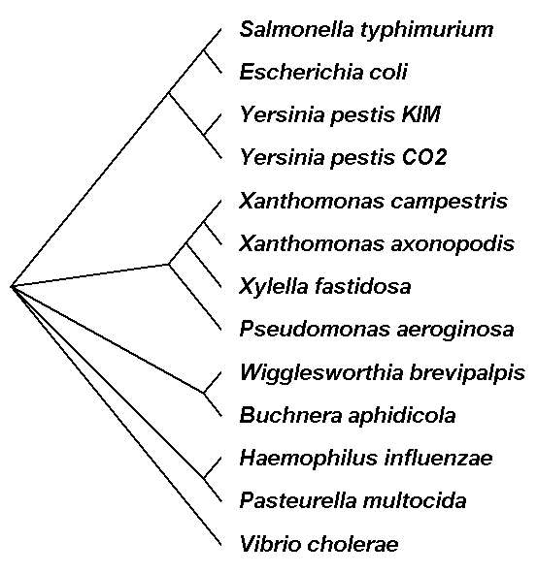
Consensus clusters of eight significantly supported bipartitions
Phylogeny of putatively transferred gene
(virulence factor homologs (mviN))
only 258 genes analyzed

Slide 17

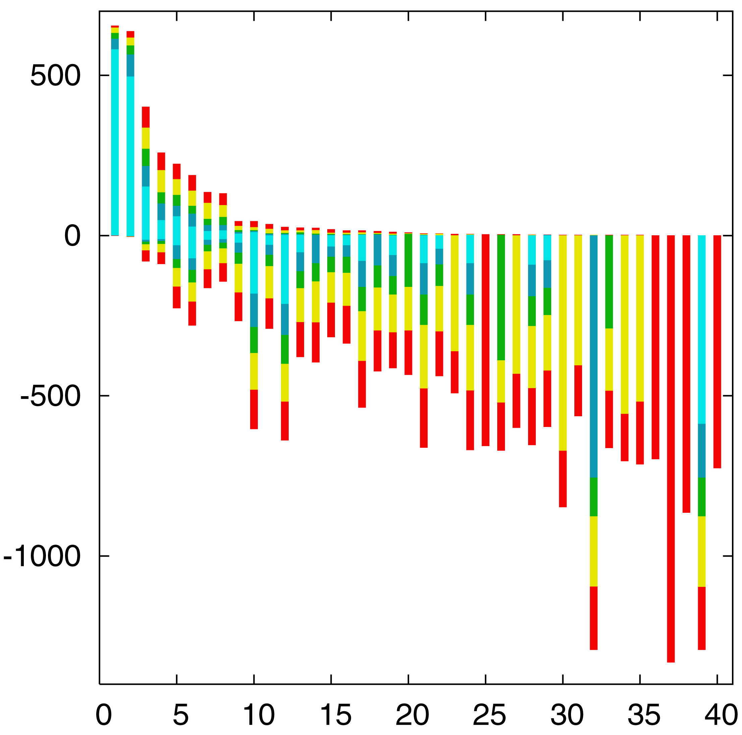
“Lento”-plot of supported bipartitions (out of 501 possible)
10 cyanobacteria:
Anabaena
Trichodesmium
Synechocystis sp.
Prochlorococcus
marinus
(3 strains)
Marine
Synechococcus
Thermo-
synechococcus
elongatus
Gloeobacter
Nostoc
punctioforme
Number of datasets
Based on 678 sets of orthologous genes
Zhaxybayeva, Lapierre and Gogarten, Trends in Genetics, 2004, 20(5): 254-260.

Slide 18
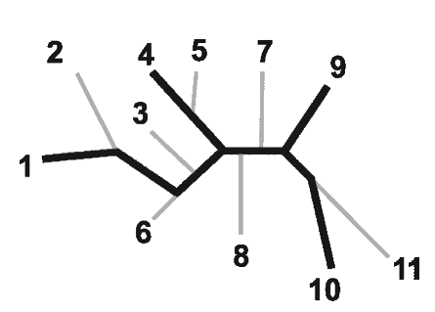
Bootstrap support values for embedded quartets
+
: tree calculated from one pseudo-sample generated by bootstraping from an alignment of one gene family present in 11 genomes
: embedded quartet for genomes
1, 4, 9, and 10 .
This bootstrap sample supports the topology ((1,4),9,10).
1
9
1
9
1
10
4
√
10
10
4
9
4
Zhaxybayeva et al. 2006, Genome Research, 16(9):1099-108
Quartet spectral analyses of genomes iterates over three loops:
Repeat for all bootstrap samples.
Repeat for all possible embedded quartets.
Repeat for all gene families.

Slide 19
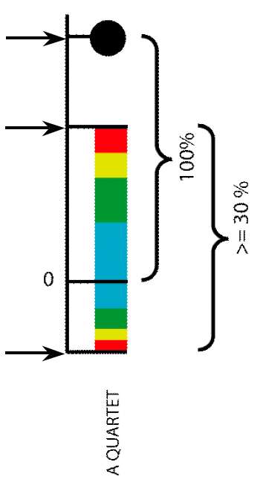
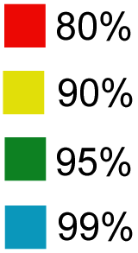
Illustration of one component of a quartet spectral analyses Summary of phylogenetic information for one genome quartet for all gene families
Total number of gene families containing the species quartet
Number of gene families supporting the same topology as the plurality
(colored according to bootstrap support level)
Number of gene families supporting one of the two alternative quartet topologies

Slide 20
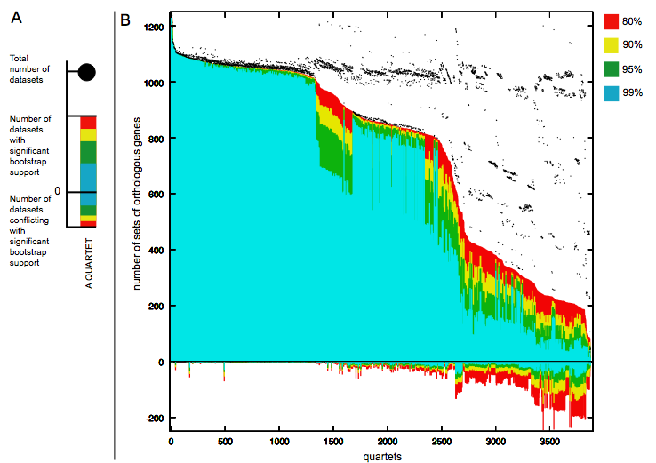
Quartet decomposition analysis of 19 Prochlorococcus and marine Synechococcus genomes. Quartets with a very short internal branch or very long external branches as well those resolved by less than 30% of gene families were excluded from the analyses to minimize artifacts of phylogenetic reconstruction.

Slide 21
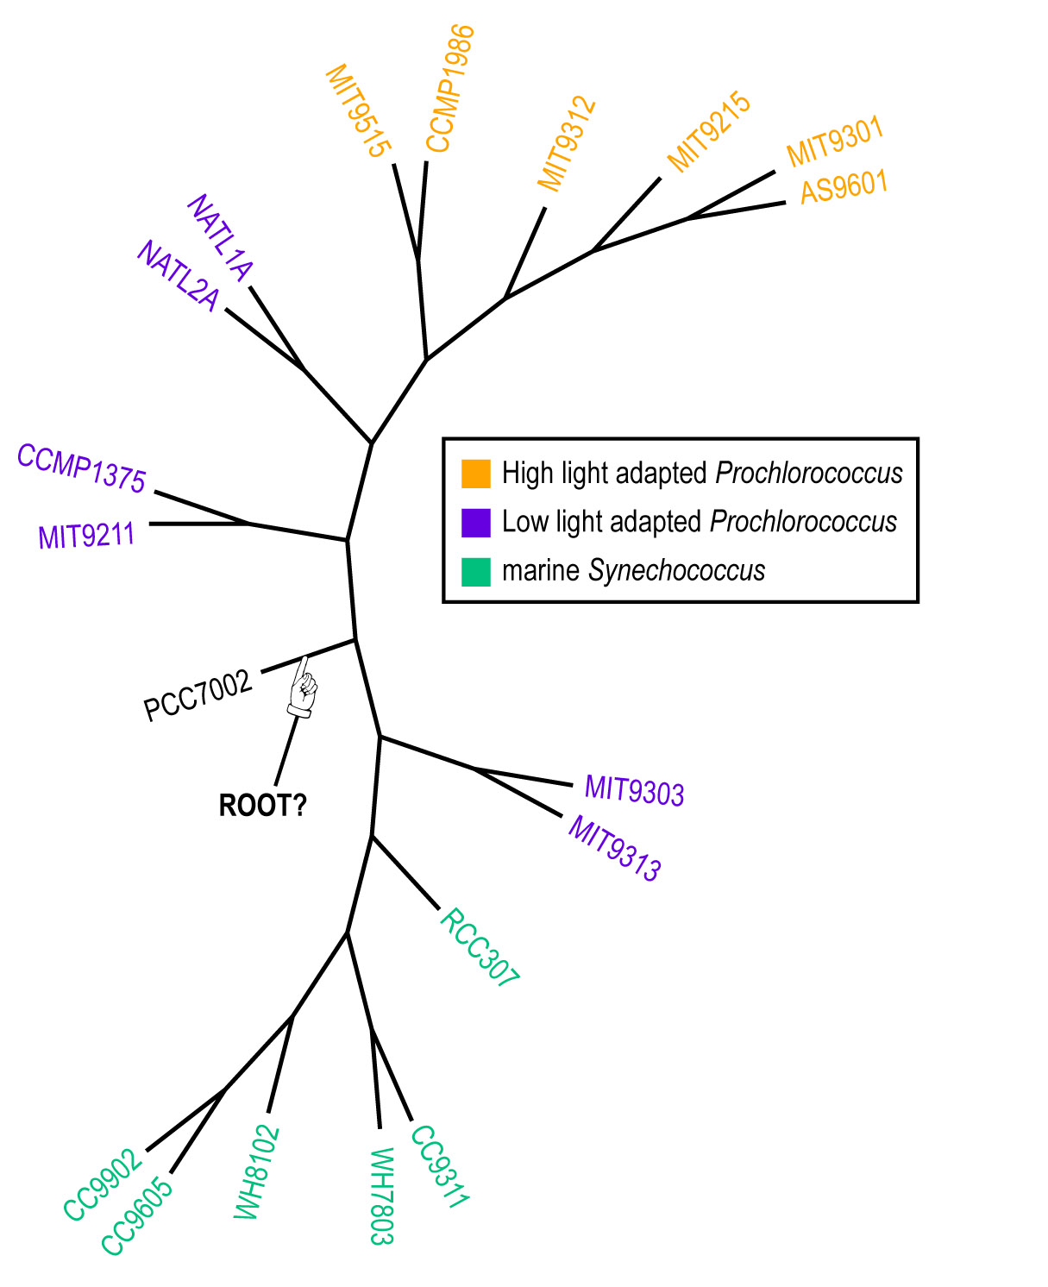
Plurality consensus calculated as supertree (MRP) from quartets in the plurality topology.

Slide 22
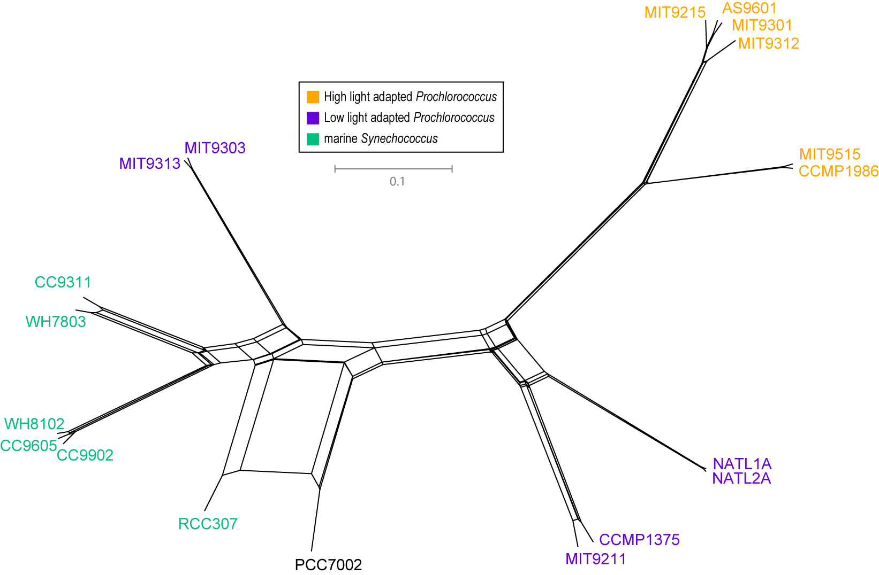
NeighborNet (calculated with SplitsTree 4.0)
Neighbor-net calculated as supertree (from the MRP matrix using SplitsTree 4.0) from all quartets significantly supported by all individual gene families (1812) without in-paralogs.

Slide 23
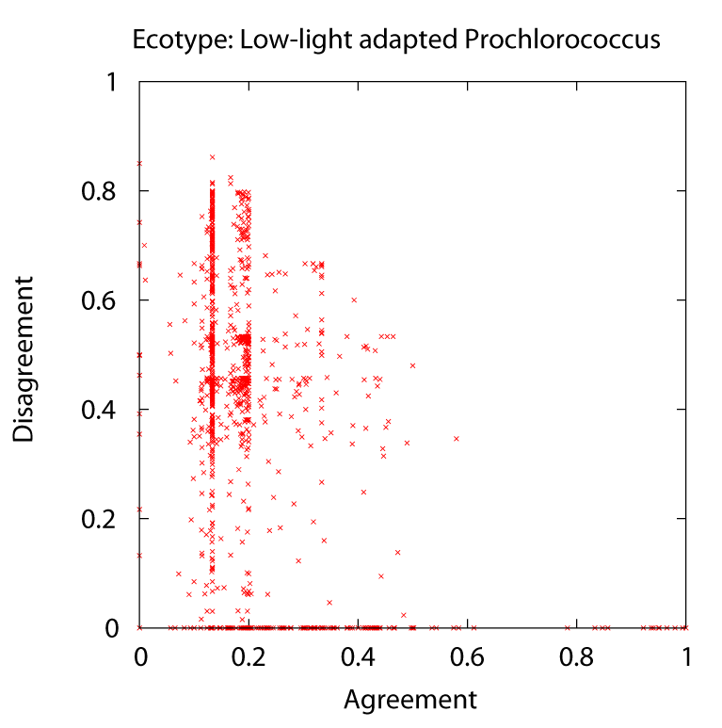
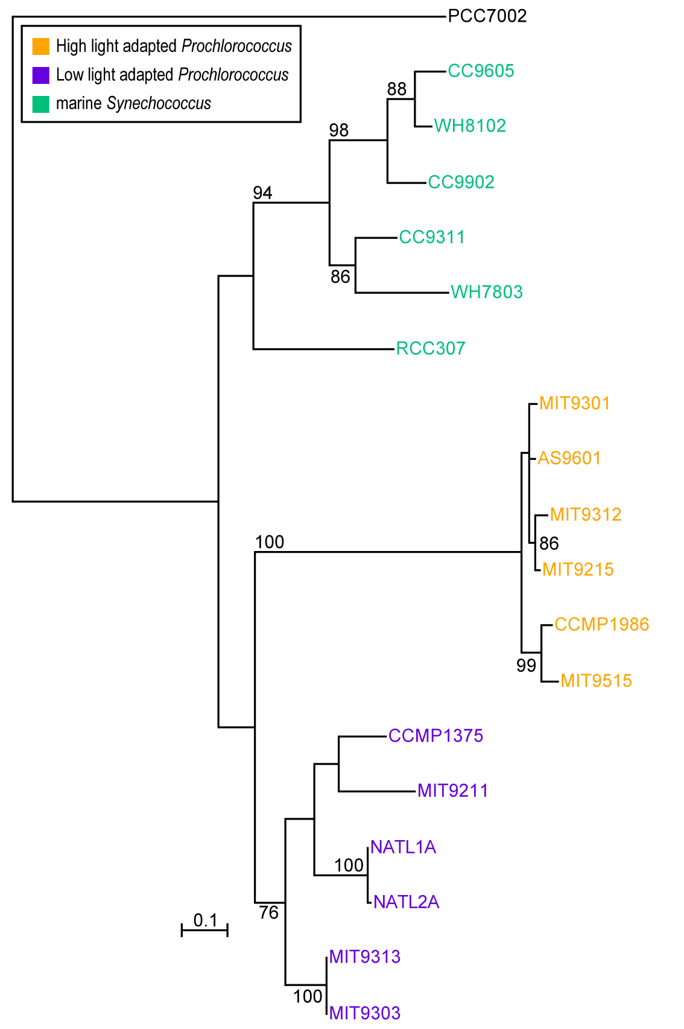
Phylogeny of delta subunit of ATP synthase.

Slide 24
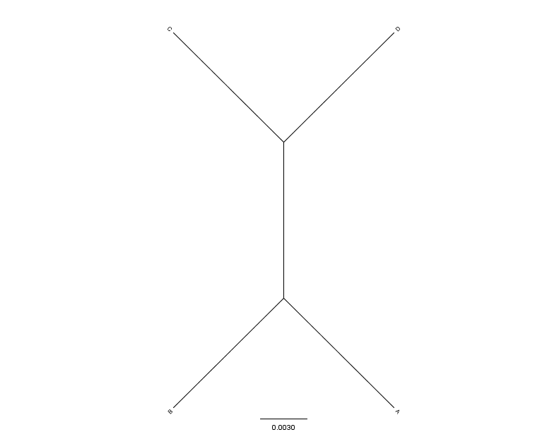
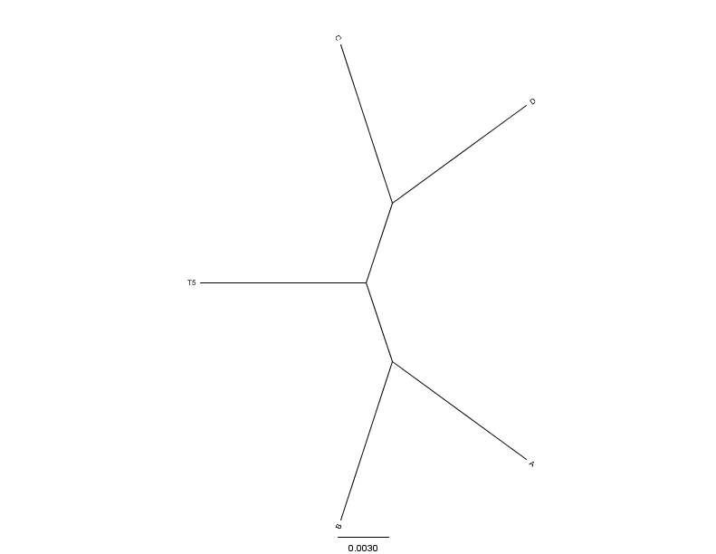
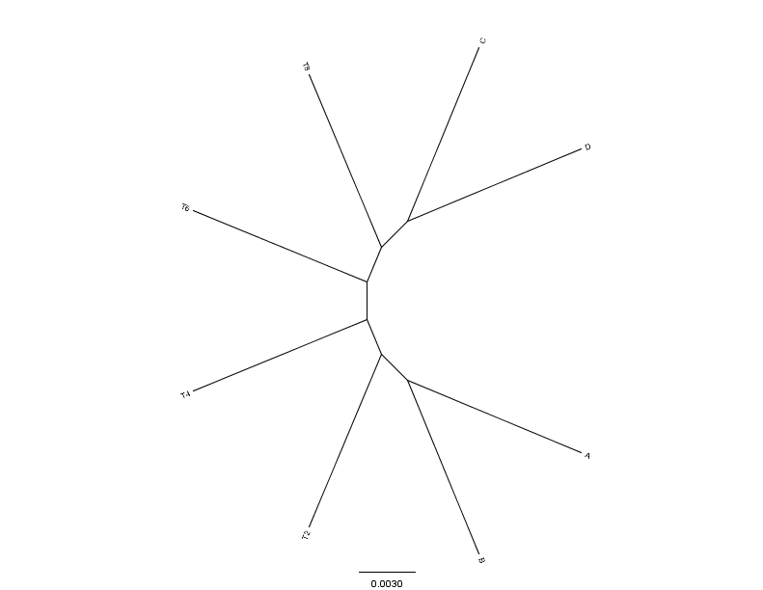
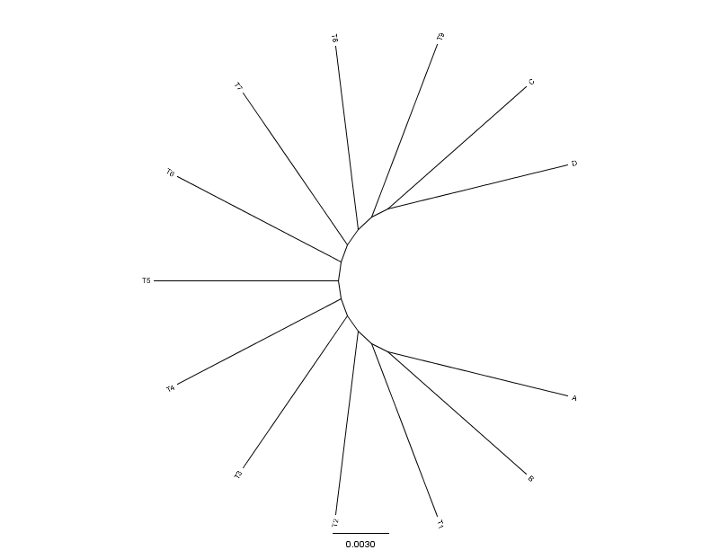
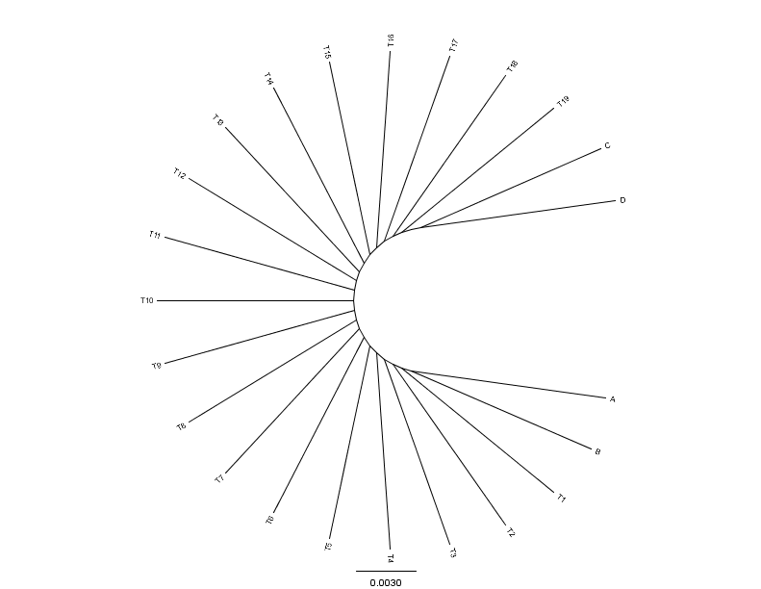
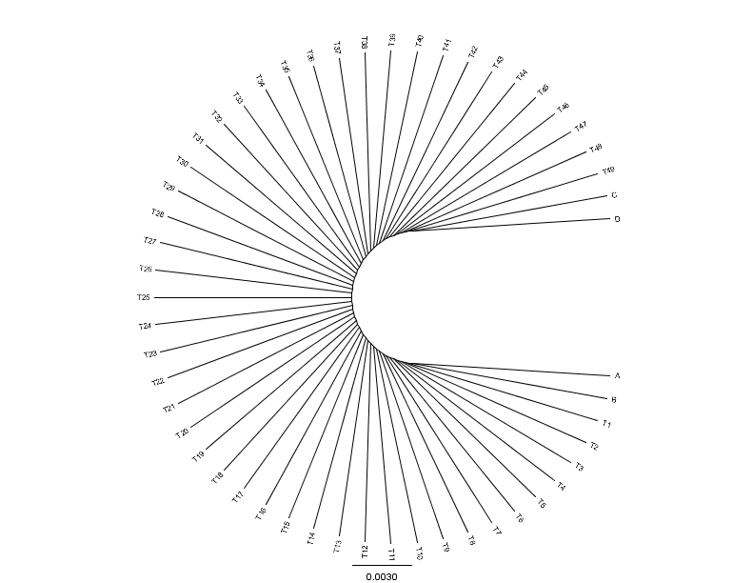
C
D
C
C
D
0.01
0.01
D
N=4(0)
N=5(1)
N=8(4)
0.01
A
0.01
0.01
B
B
B
A
A
B
C
C
D
D
C
D
A
A
A
B
B
B
N=13(9)
N=23(19)
N=53(49)
From: Mao F, Williams D, Zhaxybayeva O, Poptsova M, Lapierre P, Gogarten JP, Xu Y (2012)
BMC Bioinformatics 13:123, doi:10.1186/1471-2105-13-123

Slide 25


Results :
Maximum Bootstrap Support value for Bipartition separating (AB) and (CD)
Maximum Bootstrap Support value
for embedded Quartet (AB),(CD)

Slide 26
Bipartition Paradox:
The more sequences are added, the lower the support for bipartitions that include all sequences. The more data one uses, the lower the bootstrap support values become.
This paradox disappears when only embedded splits for 4 sequences are considered.

